Slide 1
Los Angeles County
Dept. of Military & Veterans Affairs

Slide 2
Claim Activity per Location
Office Location | Number of Claims
Bob Hope Patriotic Hall | 393
Temple VA/LASD | 182
West Covina | 188
West Los Angeles VA/Culver City | 87
Gardena Vet Center/Hawthorne: | 93
El Monte (DPSS) | 276
Office Location | Number of Claims
Whittier/Pico Rivera/Norwalk | 79
Monrovia/E. San Gabriel/ LA Verne | 121
Antelope Valley | 318
Long Beach VA/Cerritos | 253
Sepulveda VA | 281
Santa Clarita/Sherman Oaks | 117

Slide 3
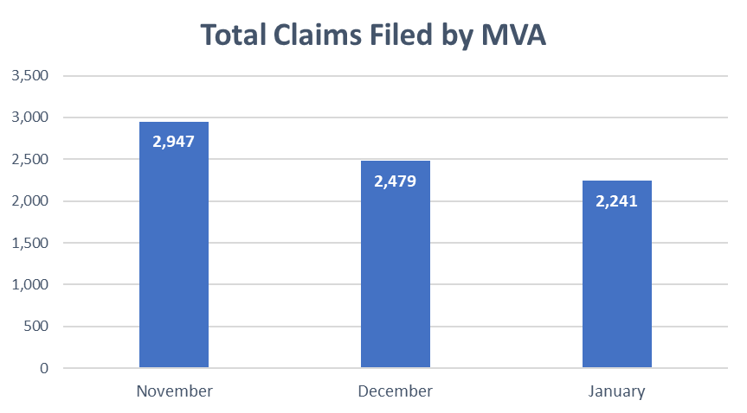
Types of Claims
December Breakdown
Compensation | 531
Pension | 0
Education/VR&E | 79
Financial/Insurance | 3
Healthcare | 12
Cost Avoidance | 124
DIC/Widow Benefits | 29
Misc. Claim Activities (Non-Auditable) | 1,463
TOTAL | 2,241

Slide 4
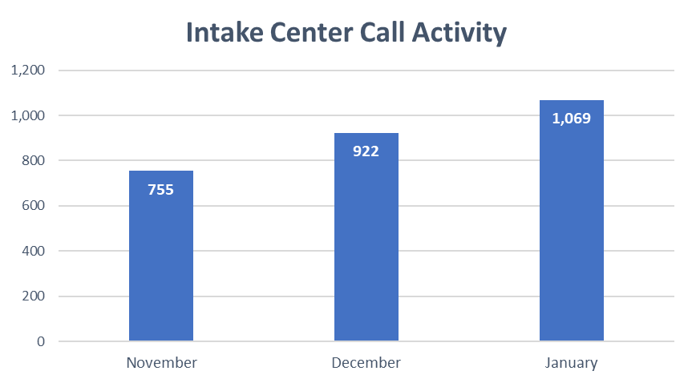
Intake Center Report (AWS)
Call Center Engagement
Contacts handled: 701
Agent answer rate: 87.57%
Average agent interaction time: 5:01 min
Call Center Efficiency
Agent callback (missed calls): 368
Agent callback connection rate: 87.25%
Average agent callback interaction time: 3:26 min
Agent callback non-connect: 57

Slide 5
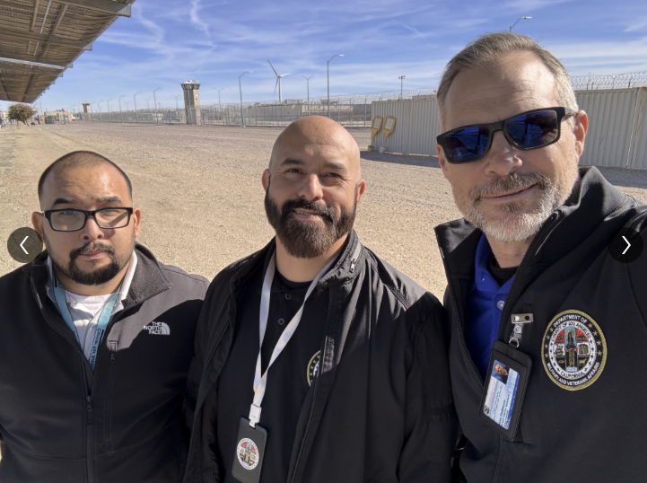
Justice-Involved Program
January Highlights
Lancaster State Prisons:
Processed 6 claims.
Visited 23 Veterans
County Jail Facilities:
Served 73 veterans
Veteran Treatment Courts:
Coordinating with Veteran Justice Team to provide support in Lancaster and Long Beach Treatment Courts
Funding:
Received $250,000 for program evaluation. Contract has been established. Evalution set to begin 2/18/25
Caption: JIV Team Visiting Lancaster State Prison

Slide 6
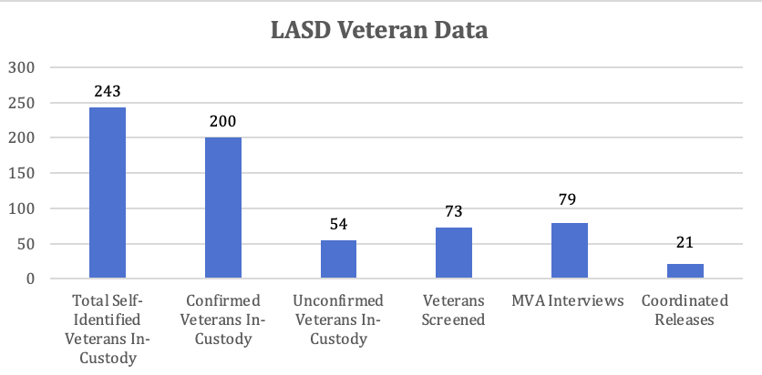
Justice-Involved Program

Slide 7
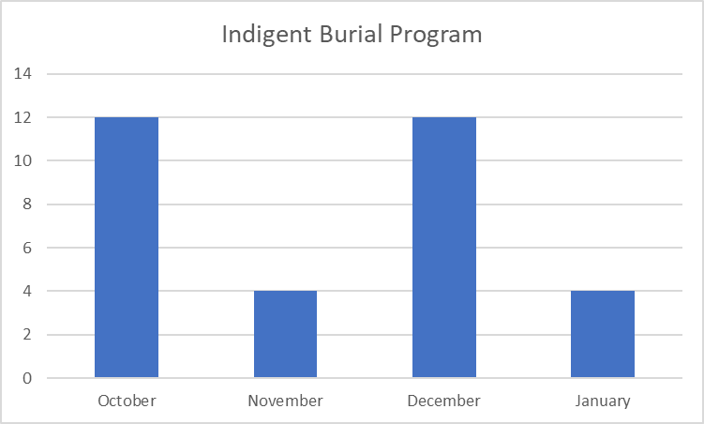
Indigent Burial Program
January Breakdown
Burial Program Activity: 4 referrals from Los Angeles County Department of Medical Examiner
*Monetary awards posted 35-45 days after formal claim submittal

Slide 8
1807 Program
January Breakdown
Military Verification and Referral Form (MC05) | 122
Qualified Claims Processed (VA Form 21-526M) | 2*
MVA Partnership with the Department of Public Social Services (DPSS)
Current Focus:
Increase claims for Veteran Medi-Cal applicants/beneficiaries.
Raise awareness of the Medi-Cal Cost Avoidance Program amongst the DPSS staff.

Slide 9
Homeless Services Division
Homeless Veterans Served*: 64
Claims filed in January 2025: 99
Outreach and Partner Collaboration:
VA One Team
BNL Weekly Meetings
Red Cross Disaster Volunteers
Pan Pacific Park ER Shelter Fire Victims
Disaster Recovery Pasadena
Red Cross Support at Bob Hope Patriotic Hall
USC Blitz Days supporting Veterans experiencing homelessness in the field
*Value reflects self-identified veterans experiencing homelessness

Slide 10
Homeless Services Division
January Breakdown
Compensation | 17
Pension | 2
Burial | 1
Education | 1
Intent to File | 7
Dependency Claim | 1
Cost Avoidance | 7
Misc. Claim Activities (Non-Auditable) | 52
Appeal | 11
TOTAL | 99
Homeless Veterans Served*: 64
Claims filed in January 2025: 99
Note: some Veterans may have more than 1 claim they wanted to file
*Value reflects self-identified veterans experiencing homelessness

Slide 11
Homeless Services Division
Location | Leased Out Count | Total Units
LACDA | 2,065 | 3,442
HACLA | 2,625 | 4,865
City of Pasadena | 28 | 32
City of Glendale | 7 | 15
City of Burbank | 11 | 15
City of Inglewood | 50 | 50
City of Torrance | 11 | 25
City of Santa Monica | 22 | 35
City of Redondo Beach | 35 | 50
*Updates are based on the HUD's online dashboard or information received from PHAs

Slide 12
Aging Veterans Referral Program
1referral processed from A&D connecting aging veterans and their caregivers to veteran and community resources​.
MVA provided veteran Quarterly cultural competency and referral refresher training to A&D on 11/14 in a focused effort to drive underserved veteran seniors to MVA.

Slide 13
Building Operations - Visitor Data
Annual Totals
Office Visited | FY 24-25 | FY 23-24 | DLY
MVA | 4097 | 5104 | (1007)
US Vets | 281 | 114 | 167
AJCC | 588 | 654 | -66
DMH | 200 | 104 | 96
Support Tenants | 107 | 0 | 107
Events | 3052 | 4041 | -989
FY TOTAL | 8,325 | 10,017 | (1692)
Annual Totals
Visit Reason | FY 24-25 | FY 23-24 | DLY
Veteran Benefits | 3997 | 4757 | (773)
Legal Assistance | 203 | 27 | 13
Meeting | 428 | 810 | -382
Employment Services | 635 | 705 | -70
Mental Health | 199 | 121 | 78
Housing | 39 | 11 | 28
Other | 2824 | 2589 | -765
FY Totals: | 8,325 | 10,017 | (1692)
Visitor Volume Review through January 2025
Through the first 7 months of the fiscal year, building volume down -1692.
BHPH is on track to see 14,000 visitors.
MVA office visits and events are down a combined 1000 from last year.

Slide 14
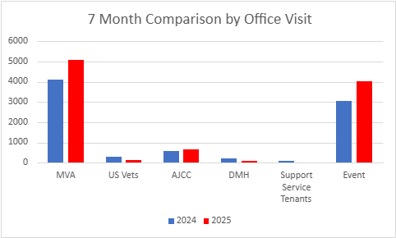
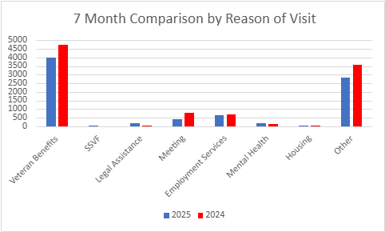
Building Operations – Visitor Data

Slide 15
January Visitor Data

Slide 16
Post Satisfaction Survey – Fiscal YTD

Slide 17
Fiscal
Budget Request
End Veteran Homelessness
Identify adequate funding to end veteran homelessness in three years
Justice-Involved Veterans
Identify adequate funding to comply with the Board’s mandate to support this vulnerable population
Suicide Prevention
Identify adequate funding to comply with the Board’s mandate to prevent veteran suicide
Administrative Support
Need for higher level leadership
Increase in administrative activities –contracts, federal billing and tracking, and HR services
Direct Services
Increase in direct services activities – agreements with cities for veteran service centers
DHR Shared Services and County Counsel
DHR Shared Services are unavoidable costs due to higher personnel activity
Significant increase in county counsel fees due to more contracts and grants reviews from previous fiscal years

Slide 18
Human Resources
NEW HIRES BY CLASSIFICATION
 | Jul | Aug | Sep | Oct | Nov | Dec | Jan
Sup. VC | 1 |  | 1
VCA III |  |  |  |  | 1
VCA II |  |  |  | 4
VIP | 1
MA |  | 1 |  | 1 |  |  | 1
ITC |  |  | 1
GNRL MNT WRK |  | 1
SA I |  |  |  | 3
TOTAL | 2 | 2 | 2 | 8 | 1 | 0 | 1
Since the beginning of the Fiscal Year, we have hired 9 staff to support our Vet Services Division, 4 staff to support our Administration Division, and 3 staff to support our Building Operations Division.
We have leveraged the emergency hiring authority to hire quality candidates as quickly as possible

Slide 19
Human Resources
PROMOTIONS BY CLASSIFICATION
 | Jul | Aug | Sep | Oct | Nov | Dec | Jan
Sup. VC |  |  |  | 1
VCA III
VCA II
ASM I |  |  | 1
MA |  | 1
TOTAL | 0 | 1 | 1 | 1 | 0 | 0 | 0
Since the start of the fiscal year, we promoted three internal candidates.
We continue to focus on creating upward mobility within the Department and retain talent.

Slide 20
Human Resources
Vacancy Rate
July | 32%
August | 29%
September | 28%
October | 18%
November | 16%
December | 24%
January | 24%
Between May 1st and June 30th, we promoted three internal staff, onboarded two staff members, one staff resigned, and one staff retired, which dropped our vacancy rate by 2% in June.
Between July 1st and September 30th, we received seven items for the Veteran Services Division, onboarded four staff to assist with building and administrative operations and one staff resigned. This dropped our vacancy rate by 4%.
Between October 1st and December 31st, we received two additional positions to assist with Admin and IT, onboarded nine staff, two staff resigned, and one staff accepted a position with another county department. This dropped our vacancy rate by 4%.
As of January 31st, we onboarded one staff to assist with Admin services and one staff accepted a position with another county department which kept our vacancy rate the same.

Slide 21
Human Resources
MVA VOLUNTEER MONTHLY BREAKDOWN
 | Jul | Aug | Sep | Oct | Nov | Dec
Volunteers | 2 | 1 | 1 | 2 | 1 | 3
VA Work Study | 1 | 1 | 2 | 2 | 0 | 0
Transitional Subsidized Employment | 0 | 2 | 0 | 1 | 0 | 0
The automated volunteer platform system has allowed volunteers to apply for positions and track their volunteer hours online and on their smartphones.
The department is working with the Los Angeles and Palmdale workforce development offices to request resumes and conduct interviews to onboard Transitional Subsidized Employment (TSE) candidates as well as working with the VA to onboard Work Study applicants.
In November and December, the VA Work-Study recruitment slowed due to college winter break. Work-study's will return when their spring semester begins.

Slide 22
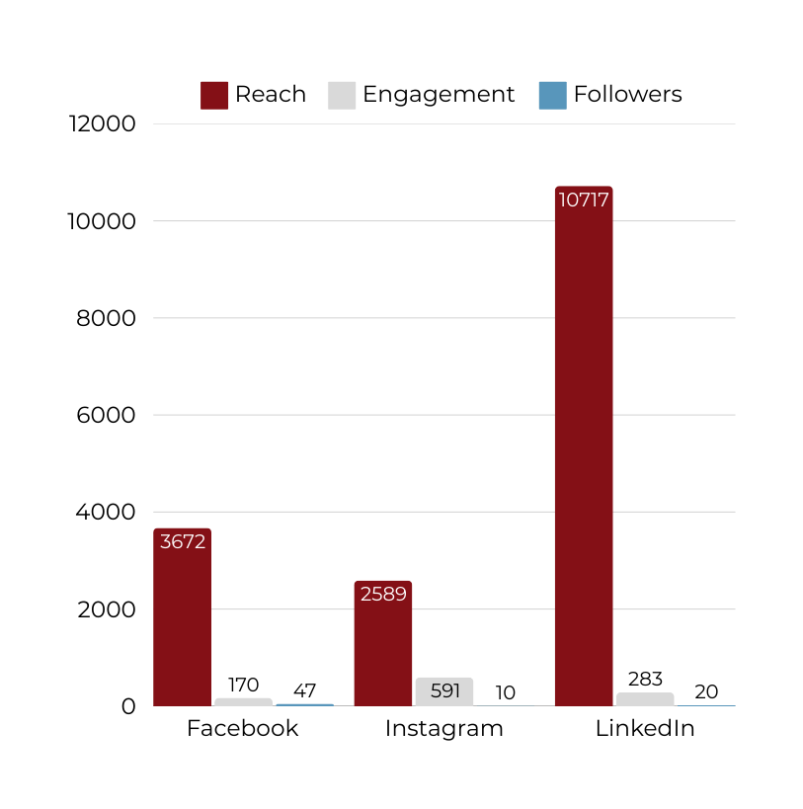
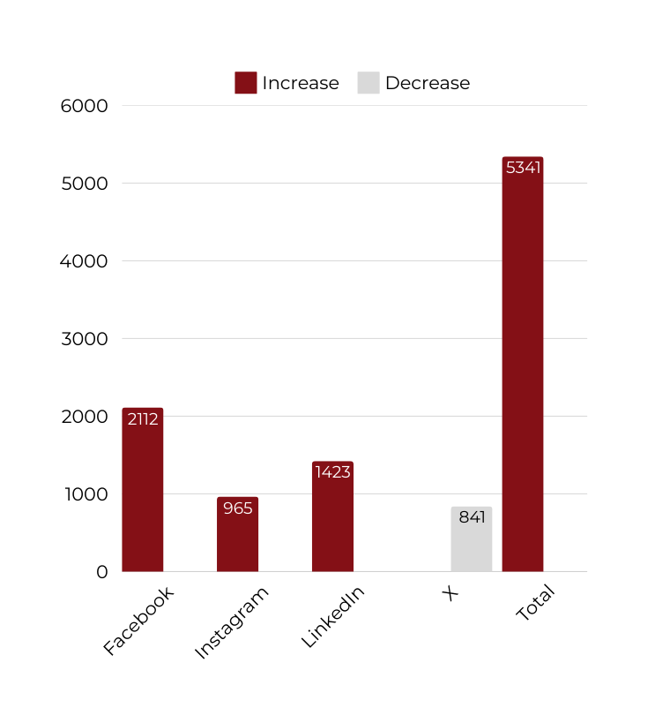
Communications
Insights from the Past 30 Days as of January 1, 2025
Notes:
Editor Link for the Graph: https://docs.google.com/spreadsheets/d/1_ssbVpe5b_WPYlT1PM0ahBXxQttu1jhquPo6L05TDkI/edit?usp=sharing

