Slide 1

Los Angeles County
Dept. of Military & Veterans Affairs
October 2025
Commission Meeting Presentation

Slide 2

Claim Activity per Location
Office Location | Number of Claims
Bob Hope Patriotic Hall | 741
VPAN – El Monte Rally Point | 80
Temple VA | 34
West Covina | 363
El Monte (DPSS) | 132
VPAN – Establishing SD2 Rally Point | N/A
West Los Angeles VA/Culver City | 317
VPAN – Sherman Oaks | 111
Sepulveda VA | 113
Office Location | Number of Claims
Chatsworth Veteran Center | 33
VPAN – South Gate Rally Point | 85
Whittier/Pico Rivera/Norwalk | 77
Long Beach VA | 210
Artesia/Paramount/Bell Shelter | 49
VPAN – Palmdale Rally Point | 311
Antelope Valley Veteran Center | 322
Santa Clarita | 157
Monrovia/E. San Gabriel/La Verne | 114

Slide 3
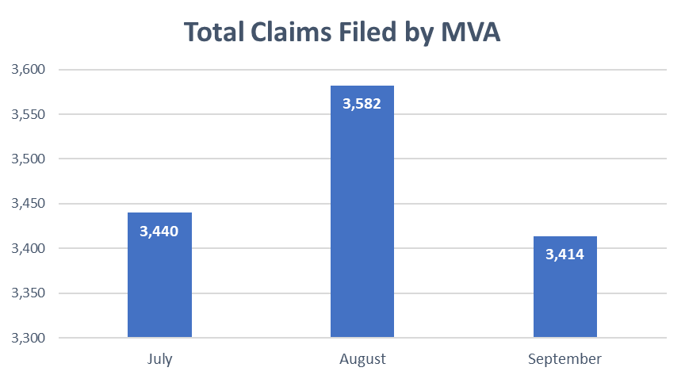
Types of Claims
September Breakdown
Compensation | 673
Pension | 1
Education/VR&E | 239
Financial/Insurance | 4
Healthcare | 43
Cost Avoidance | 145
DIC/Widow Benefits | 32
Misc. Claim Activities (Non-Auditable) | 2026
TOTAL | 3,414

Slide 4
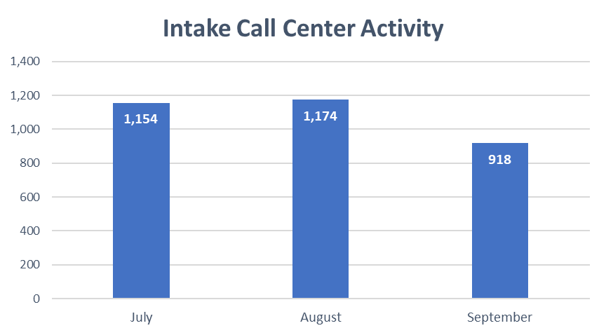
Intake Center Report (AWS)
Call Center Engagement
Contacts handled: 918
Agent answer rate: 80.30%
Average agent interaction time: 3:23 min
Call Center Efficiency
Agent callback (missed calls): 108
Agent callback connection rate: 94.43%
Average agent callback interaction time: 2:51 min
Agent callback non-connect: 74

Slide 5
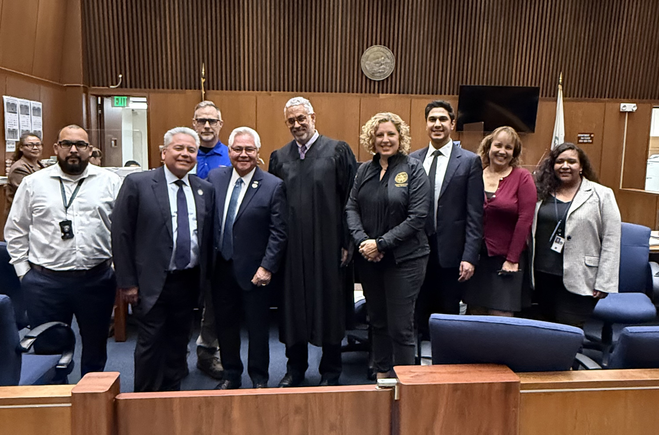
Justice-Involved Program
July Highlights
Program Updates
CCJCC Subcommittee Ad Hocs Convened: Advanced VTC standardization and JIV identification strategies through interagency collaboration.
Court Standardization: MVA shared sample MOUs and protocols; DA and PD reviewing policies; court engagement initiated.
Veteran Identification: LASD signage coordination underway; MIL-100 expansion in progress; digital submission options explored.
Custody Data Deep Dive: JIV Division identified 565 veterans in custody countywide from January to June 2025.
Direct Services: JIV Division visited 87 veterans in custody in July and assisted 3 veterans with court referrals to treatment and housing.
Caption: Senator Bob Archuleta and Assemblymember Pilar Schiavo visited Clara Shortridge Foltz Criminal Justice Center to see the Justice-Involved Veterans team in action.

Slide 6
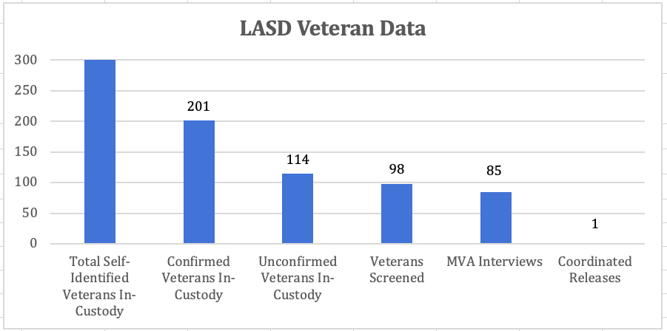
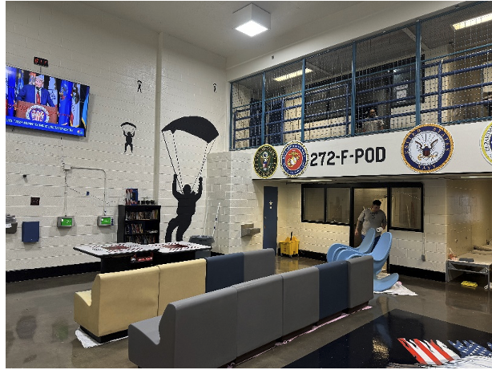
Justice-Involved Program
*Updates are based on the information received from LASD
Caption: TWIN TOWERS CORRECTIONAL FACILITY – T272-F (MOH VETERANS)

Slide 7
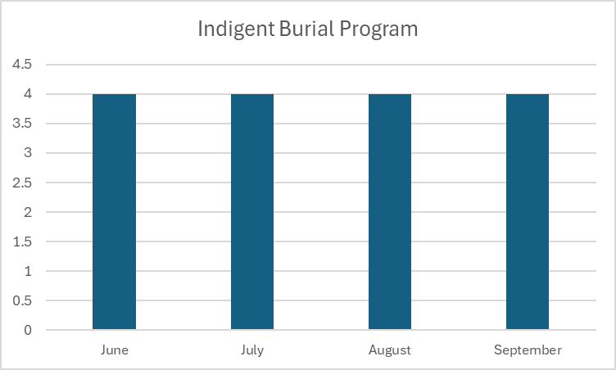
Indigent Burial Program
September Breakdown
Burial Program Activity: 4 referrals from Los Angeles County Department of Medical Examiner
*Monetary awards posted 35-45 days after formal claim submittal

Slide 8
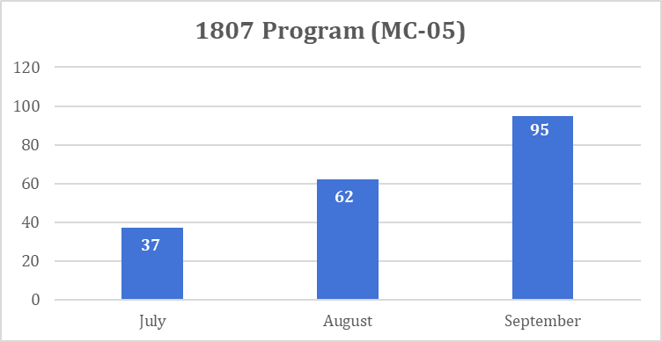
1807 Program
September Breakdown
Military Verification and Referral Form (MC05) | 95
Qualified Claims Processed (VA Form 21-526M) | 0
MVA Partnership with the Department of Public Social Services (DPSS)
Current Focus:
Outreach to DPSS Veterans – MVA flyer will be mailed to DPSS households reporting a veteran by September 12, 2025
Increase claims for Veteran Medi-Cal applicants/beneficiaries

Slide 9
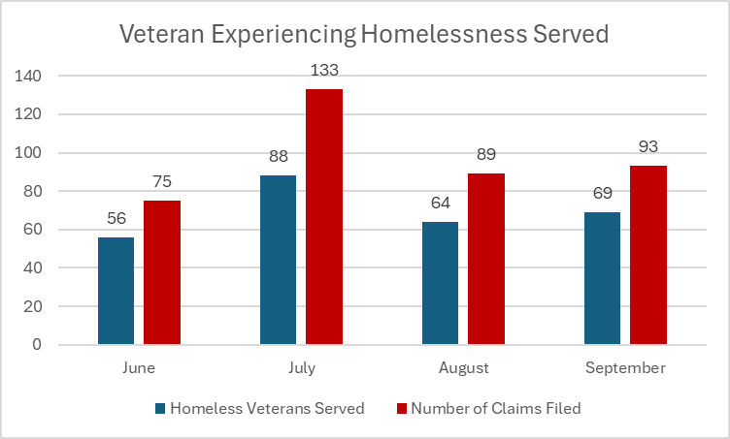
Homeless Services Division
September Breakdown
Homeless Veterans Served*: 69
Claims filed in September 2025: 93
Outreach and Partner Collaboration:
Housing Navigation Kick-Off Meeting with Providers
9/11 Remembrance Day – City of Hawthorne
Resource Connect Day – Pico x Union
Vet-Pledge
SPA 4 HUD-VASH Lease-Up Event
LEAP Meeting – Community Partners
*Value reflects self-identified veterans experiencing homelessness

Slide 10
Homeless Services Division
September Breakdown
Compensation | 13
Education/VR&E | 2
Intent to File | 3
Cost Avoidance | 16
Misc. Claim Activities (Non-Auditable) | 40
Appeal | 19
TOTAL | 93
September Breakdown
Homeless Veterans Served*: 69
Claims filed in September 2025: 93
Note: Some veterans may have more than 1 claim they wanted to file
*Value reflects self-identified veterans experiencing homelessness

Slide 11
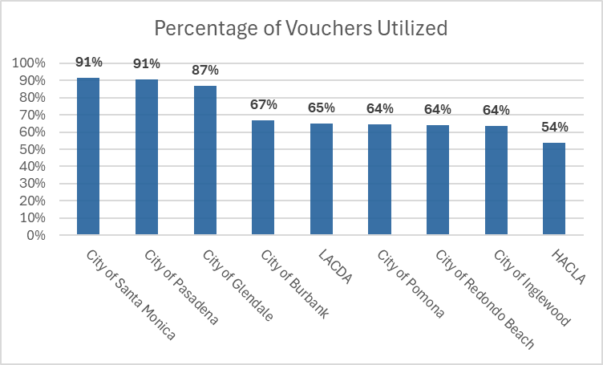
Homeless Services Division
Location | Vouchers Utilized Count | Total Units
LACDA | 2,228 | 3,442
HACLA | 2,752 | 5,115
City of Pasadena | 29 | 32
City of Glendale | 13 | 15
City of Burbank | 10 | 15
City of Inglewood | 54 | 85
City of Torrance | 11 | 25
City of Santa Monica | 32 | 35
City of Redondo Beach | 32 | 50
City of Pomona | 58 | 90
*Updates are based on the HUD's online dashboard or information received from PHAs

Slide 12
Homeless Services Division
Location | TBV Utilized Count | Total TBV Units | PBV Utilized Count | Total PBV Units
LACDA | 1712 | 2710 | 516 | 732
HACLA | 1829 | 3800 | 923 | 1315
City of Burbank | 10 | 15 | 0 | 0
City of Pasadena | 14 | 16 | 15 | 16
City of Glendale | 13 | 15 | 0 | 0
City of Inglewood | 48 | N/A | 6 | N/A
City of Torrance | 11 | 25 | 0 | 0
City of Santa Monica | 32 | 35 | 0 | 0
City of Redondo Beach | 32 | 50 | 0 | 0
City of Pomona | 22 | 39 | 36 | 51
*Requesting data for this breakdown from other PHAs.

Slide 13
Aging Veterans Referral Program
September Breakdown
No referrals processed from A&D connecting aging veterans and their caregivers to veteran and community resources​.
MVA currently redeveloping MOU and programing with A&D

Slide 14
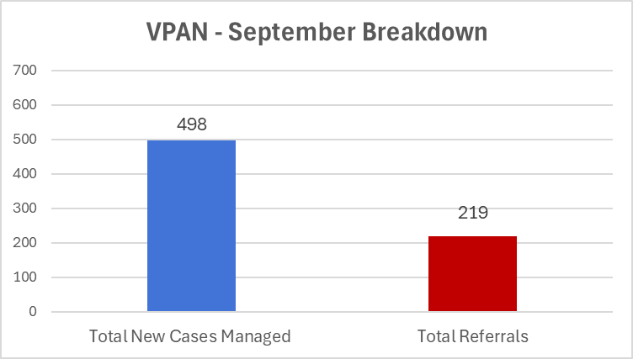
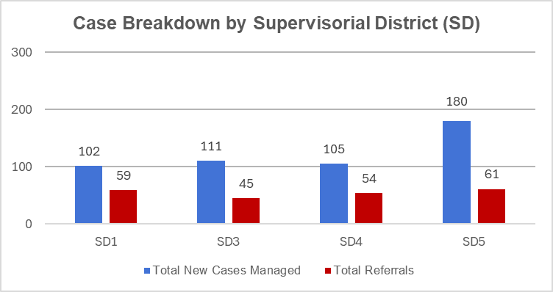
Veteran Peer Access Network (VPAN)
Service Type
Service Type | Cases Managed
Individual & Family Support | 285
Income Support | 161
Housing & Shelter | 120
Employment | 80
Benefits Navigation | 75
Legal | 51
Transportation | 26
Mental/Behavorial Health | 20
Food Assistance | 13
Education | 10
Utilities | 9
Clothing & Household Goods | 7
Physical Health | 4
Money Management | 3
Social Enrichment | 1
Total | 865

Slide 15
Veteran Peer Access Network (VPAN)
September – VPAN Community Support
VPAN SD1 Heroes in the Shadow – September 12th and 13th
VPAN SD5 9/11 Memorial Event at CSUN – September 11th
VPAN SD5 Patriot Day Ceremony at Antelope Valley College – September 11th

Slide 16
Building Operations – Visitor Data
Annual Totals Office Visits
Office Visited | FY 25-26 | FY 24-25 | Variance
MVA | 2098 | 2166 | (68)
US Vets | 115 | 107 | 8
AJCC | 232 | 294 | (62)
DMH | 86 | 97 | (11)
Support Tenants | 19 | 17 | 2
Events | 2169 | 878 | 1291
FY TOTAL | 4,719 | 3,559 | 1160
Annual Totals Visit Reason For Visit
Visit Reason | FY 25-26 | FY 24-25 | Variance
Veteran Benefits | 2089 | 2103 | (14)
Legal Assistance | 52 | 55 | (3)
Meeting | 604 | 234 | 370
Employment Services | 300 | 315 | (15)
Mental Health | 85 | 104 | (19)
Housing | 2 | 16 | (14)
Other | 1587 | 732 | 855
FY Totals: | 4,719 | 3,559 | 1160
Visitor Volume Review – First quarter of new fiscal year.
Building has seen 1160 more visitors than last fiscal year through first quarter.
Warrior Heritage Foundation has created a tremendous impact on volume with events, meetings, and film/photo shoots.
The building is on pace to shatter any post renovation visitor volume records.
Notes:
ADO 04/07/2025

Slide 17
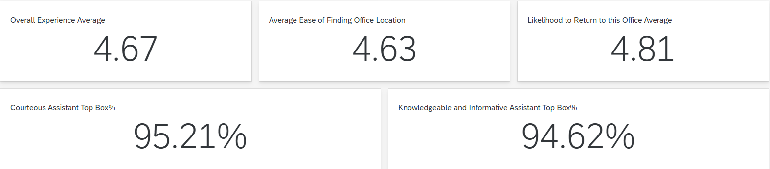
MVA Post Satisfaction Survey – CYR
Notes:
ADO 04/07/2025

Slide 18
Fiscal
Budget Update
Budget Curtailments
BSR 5th Month
MVA Measure A Funding FY26-27
Impact to MVA
Measure A is currently facing a fiscal deficit of $303 million.
The department’s focus is on identifying reductions and cost-saving measures across all existing programs and services.
No new funding requests are being accepted currently.
The department is not considering expanding or adding new programming for the upcoming fiscal year.
Current Measure A programs and services are being evaluated and maintained at their existing funding levels.
Notes:
ADO 4/7/2025

Slide 19
Human Resources
NEW HIRES BY CLASSIFICATION
 | Jan | Feb | Mar | Apr | May | Jun | Jul | Aug | Sep
Supv. VC
VCA III |  | 1 |  | 1
VCA II |  |  | 2
MA | 1 | 1
ITC |  |  |  |  |  | 1
ASM I |  |  |  | 1
IT Supv. |  |  |  |  |  |  |  |  | 1
TOTAL | 1 | 2 | 2 | 2 | 0 | 1 | 0 | 0 | 1
September Breakdown
Since the start of the year, we have successfully hired nine staff members to support our Veteran Services Division, Administrative Services Division, and Building Operations Division.
We have utilized emergency hiring authority to expedite the hiring process and secure high-quality candidates swiftly.
Notes:
ADO 04/07/2025

Slide 20
Human Resources
PROMOTIONS BY CLASSIFICATION
 | Jan | Feb | Mar | Apr | May | Jun | Jul | Aug | Sep
Sup. VC
VCA III
VCA II
ASM II |  |  |  |  |  | 1
ASM I
MA
SA I |  |  |  |  |  |  |  | 1
TOTAL | 0 | 0 | 0 | 0 | 0 | 1 | 0 | 1 | 0
September Breakdown
Since the start of the year, two internal candidates have been successfully promoted, supporting staff development and retention.
Notes:
ADO 04/07/2025

Slide 21
Human Resources
Vacancy Rate
January | 24%
February | 22%
March | 18%
April | 15%
May | 16%
June | 15%
July | 28%
August | 29%
September | 29%
September Breakdown
Between January 1st and March 31st, two staff members were onboarded for Admin Services, three for Veteran Services, and one staff member transitioned to another county department, resulting in a 6% decrease in the vacancy rate.
Between April 1st and June 30th, two staff members were onboarded to assist the Veteran Services Division, one staff member was onboarded to assist the Admin Services Division, one staff member was released, and one VCA I position was frozen due to the curtailment, resulting in no change in the vacancy rate.
Between July 31st and September 30th, the department received eight positions for the Veteran Services Division and one position in IT. Additionally, one staff member was onboarded to assist the IT Division, two staff members resigned from county service and one staff member transitioned to another county department resulting in a 1% increase in vacancy rate.
Notes:
ADO 04/07/2025

Slide 22
Human Resources
MVA VOLUNTEER MONTHLY BREAKDOWN
 | Volunteers | VA Work Study | Transitional Subsidized Employment
January | 1
February | 1 | 2
March
April |  | 1 | 1
May |  | 2 | 2
June | 2 | 3 | 1
July | 3 | 1 | 1
August | 1 | 1 | 2
September | 2 | 1 | 0
September Breakdown
Since the start of the year, 10 new volunteers were successfully onboarded, assisting at various MVA offices, media support, and public relations efforts.
In collaboration with the Los Angeles and Palmdale Workforce Development offices, the department has successful onboarding of seven TSE candidates. As the program did not receive funding for next year, the department will maintain the active TSEs for the remainder of their contract through next summer but will no longer receive any new candidates.
The department is working with the VA to onboard Work Study applicants. Since the start of the year, recruitment efforts have successfully resulted in the placement of 10 veteran student at MVA satellite offices.
Notes:
ADO 04/07/2025

Slide 23

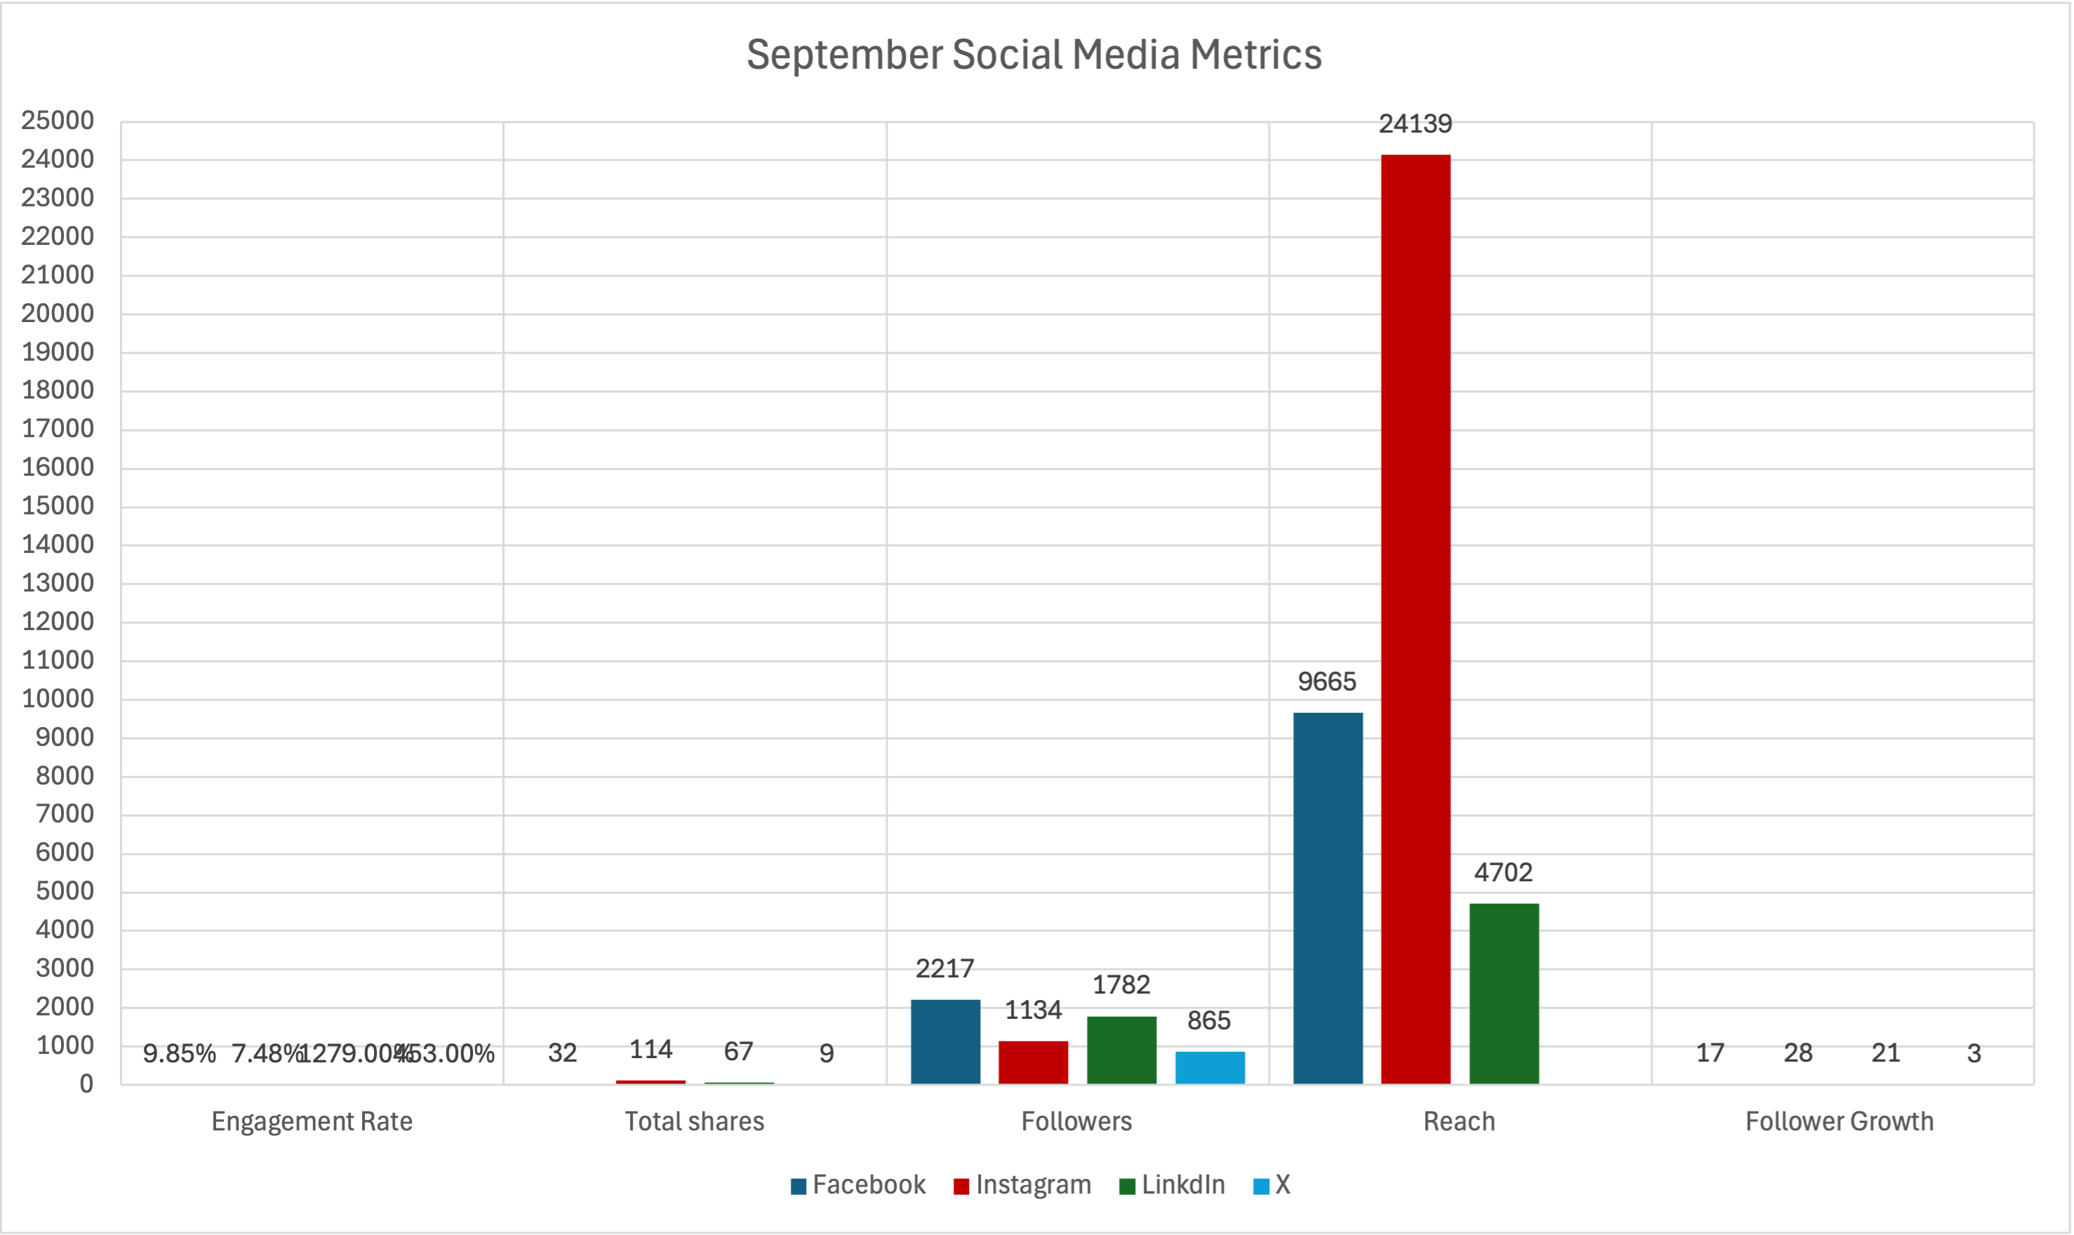
Communications
Communication Insights September, 2025
NEXTDOOR METRICS
Metric (avg. Per post) | Value
Total Posts | 7
Average Impressions | 8255

Slide 24
Legislative Updates – State Legislation
Senate Bills
SB28 – Hearing Postponed
SB54 – In Senate. Ordered to engrossing and enrolling.
SB55 – Held in Committee (Assembly)
SB56 – Held in Committee (Assembly)
SB67 – Ordered Third Reading (Assembly)
SB284 – Held in Suspense (Assembly)
SB296 – Held in Suspense (Assembly)
SB855 – Ordered Third Reading (Assembly)
SB694 – Referred to Senate Rules

Slide 25
Legislative Updates – State Legislation
Assembly Bills
AB 30 – In Assembly. Ordered to Engrossing and Enrolling.
AB 81 – In Assembly. Ordered to Engrossing and Enrolling.
AB 88 – In Assembly. Ordered to Engrossing and Enrolling.
AB 264 – Ordered to Inactive File (Senate)
AB 571 – To Engrossing and Enrolling.
AB 587 - Ordered Third Reading (Senate)
AB 1412 - Enrolled and presented to the Governor
AB 1508 – In Assembly. Ordered to Engrossing and Enrolling
AB 1509 – Enrolled and presented to the Governor

Slide 26

Official Partner Of
LA COUNTY DEPARTMENT OF MILITARY AND VETERANS AFFAIRS

Slide 27

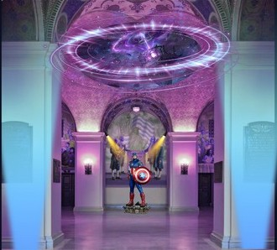
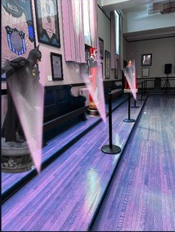

Comic Con
SEPTEMBER 27
ENTIRE A- LIST “ AVENGERS’” CAST APPEARING AT BOB HOPE PATRIOTIC HALL WHF ASKED BY COMIC CON TO SPEAK ABOUT PATRIOTIC HALL AND THE
POWERFUL BOND BETWEEN VETERANS AND SUPERHEROES

Slide 28


Hispanic Heritage Month
“ AMERICAN SONS” SCREENING - OCTOBER 8
IN CONJUNCTION WITH SUPERVISOR SOLIS’ OFFICE, AND PBS SOCAL WHF IS SCREENING THE AWARD- WINNING DOCUMENTARY “ AMERICAN SONS,” WHICH PREMIERED AT SOUTH BY SOUTHWEST.
Los Angeles Veterans Orientation
SEPTEMBER 26
LAVO IS UTILIZED AS AN INTRODUCTION AND RECRUITMENT OF ACTIVE DUTY MEMBERS IN THE LA COUNTY AREA TO WHF’ S NEW PREMIERE TRANSITION PROGRAM LAUNCHING IN 2026

Slide 29

BOB HOPE PATRIOTIC HALL
CLIENTS SUCH AS COMIC CON, ESPN, AND SHUTTERSTOCK THIS MONTH
INDUSTRY LEADERS NOW RECOGNIZING BHPH AS ONE OF LOS ANGELES’ PREMIER DESTINATIONS FOR EVENTS AND FILMING

Slide 30
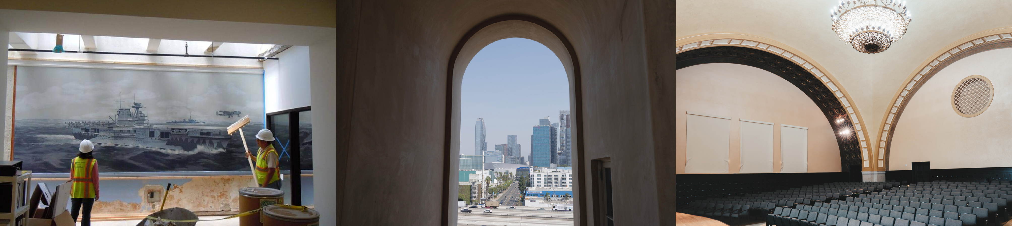
Barriers
VSOS HAVE BEEN RESERVING THE SPACE FREE OF CHARGE FOR THEIR EVENTS BUT THEN CANCELING AT
THE LAST MINUTE. THIS PREVENTS US FROM GENERATING REVENUE THAT DIRECTLY SUPPORTS VETERANS AND ALSO WASTES VALUABLE TIME THAT COULD BE USED FOR MISSION- DRIVEN PROGRAMMING.
Solution
IMPLEMENTING A REFUNDABLE DEPOSIT AT TIME OF BOOKING

Slide 31

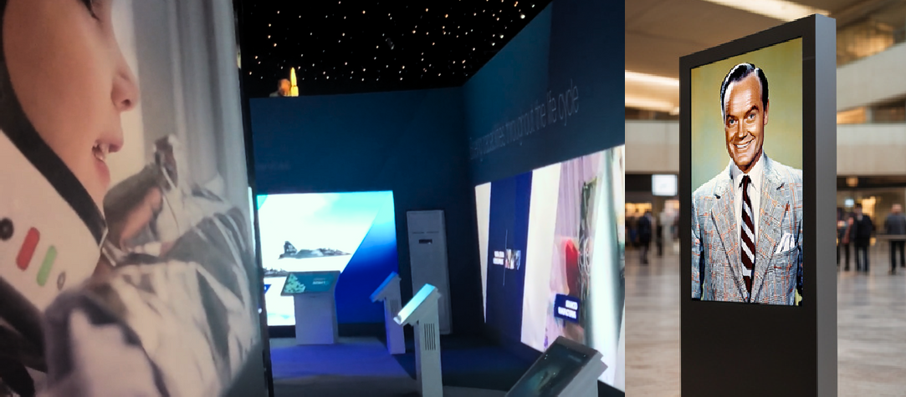
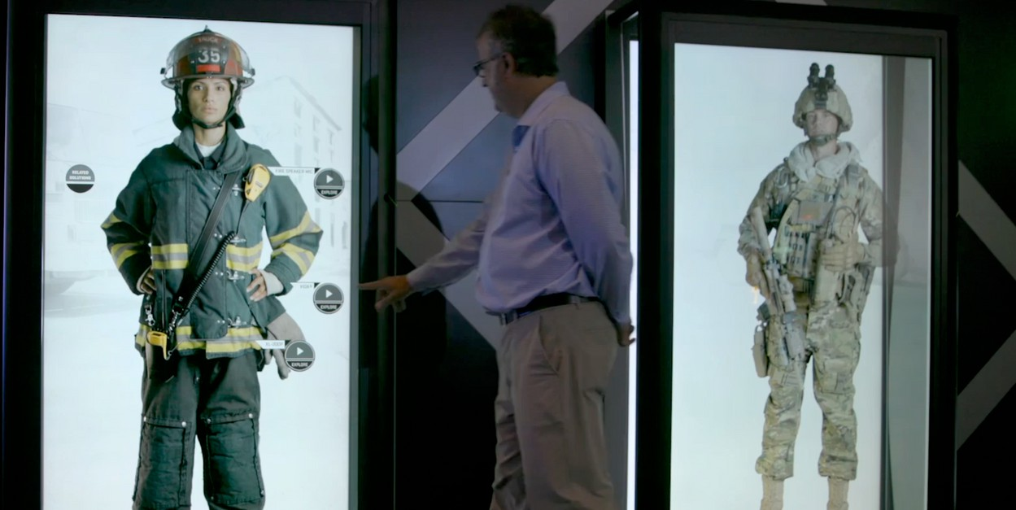

HISTORICAL PRESERVATION
AWARDED LANDMARK $ 1 . 5 MILLION PRODUCTIVITY INVESTMENT FUND GRANT TO PARTNER WITH INHANCE DIGITAL FOR CUTTING- EDGE DIGITAL CURATION TO BOB HOPE PATRIOTIC HALL
INCLUDED ARE HOLOGRAPHIC TRIBUTES TO VETERANS AND SERVICE MEMBERS, AN INTERACTIVE LED WALL, AND A BOB HOPE VIDEO KIOSK.
TOGETHER, THESE INNOVATIONS WILL INSPIRE AND EDUCATE THE PUBLIC ON THE HISTORY OF PATRIOTIC HALL AND THE PROFOUND INFLUENCE AND CONTRIBUTIONS OF VETERANS ACROSS LOS ANGELES COUNTY.

Slide 32
Official Partner Of
LA COUNTY DEPARTMENT OF MILITARY AND VETERANS AFFAIRS

Slide 33

THANK YOU.

